Slide 1
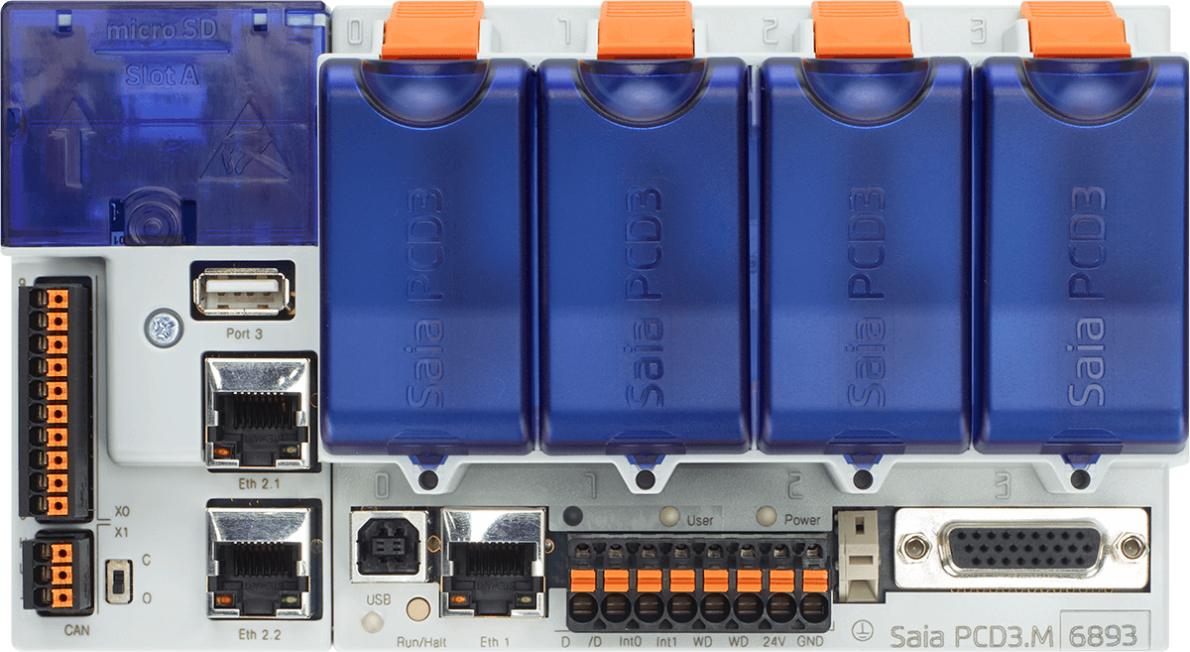
RS-232
RS-422
RS-485
Modbus
S-Bus
M-Bus
DALI
MP-Bus
2x
2x
2x
2x
Slot for PCD7.F1xx
RS-485
USB host
ETH2
USB device
ETH1
RS-485
OPC-UA, Profinet, Modbus, IEC870-5-104, HTTPS, MQTT, FTPS, SNMP, SNTP, SMTP, CAN, BACnet IP, …

